Slide 1
10/12/2022

Slide 2
4.1
The while loop

Slide 3
Iteration
Iteration, in the context of computer programming, is a process wherein a set of instructions are repeated a specified number of times or until a condition is met.
Each time the set of instructions is executed is called an iteration.
Another term for iteration is loop… the program "loops back" to an earlier step and repeats.

Slide 4
while syntax
Flowchart of while
while (boolean expression)
statement
Does boolean expression evaluate to true?
Example:
Yes
int i = 1;
while (i <= 100) {
System.out.println(i);
i++;
}
No
Execute statement
Next statement after while

Slide 5
++ and -- operators make for compact loops
Both of the loops below do the same thing. Programmers differ on style.
int i = 1;
while (i <= 100) {
System.out.println(i);
i++;
}
int i = 1;
while (i <= 100) {
System.out.println(i++);
}
i++ means post-increment, so it evaluates to the current value of i, then increments it.
What would be printed out if System.out.println(++i) was used?

Slide 6
while syntax and curly braces
while (boolean expression)
statement
Just like if, statement can be any legal statement… a single statement, or a block. This works:
int i = 1;
while (i <= 100)
System.out.println(i++);
Most Java coding conventions require curly braces even for a single statement, just like if.
int i = 1;
while (i <= 100) {
System.out.println(i++); }

Slide 7
++ and -- operators can be used in condition
You'll see this kind of cleverness sometimes.
Usually, people just use a for loop for this kind of thing. (Covered a few slides from now.)
void printSomethingManyTimes(String text, int count) { while (--count >= 0) {
System.out.println(text);
} }

Slide 8
= (assignment) can be used in the condition
Your loop condition may depend on some code that repeats every iteration:
String command = getNextCommand(); while (command != null) { executeCommand(command); command = getNextCommand();
} }
The assignment operator can be used in the condition to avoid the repetition:
String command; while ((command = getNextCommand()) != null) { executeCommand(command); } }
Programmers may differ on the style here. (The first style was used in Magpie.)

Slide 9
Sentinel values
A sentinel value is a special value that tells the loop to terminate.
The code from the previous slide is an example of this:
getNextCommand returns null when there are no more commands to execute.
String command;
while ((command = getNextCommand()) != null) {
executeCommand(command);
}
}

Slide 10
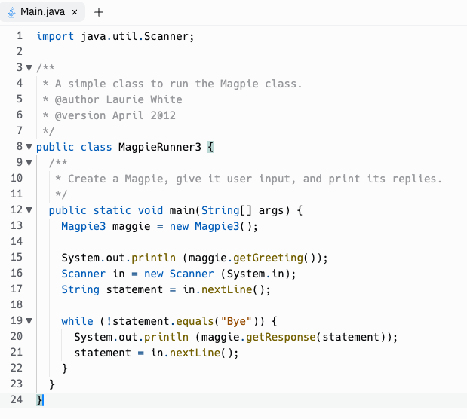
Input-controlled loops
The while loop is often used for input-controlled loops, where input is being taken from the user, or from a file on disk, or the network.
An example is the MagpieRunner, where the while loop continues until the user enters "Bye", the sentinel value which tells Magpie that no more input is coming and terminates the loop.

Slide 11
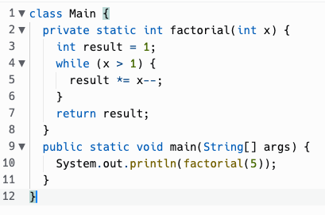
Tracing loops
Let's trace through this loop together…

Slide 12
do…while syntax
Flowchart of while
do
statement
while (boolean expression)
Execute statement
Sometimes, you want to check some condition AFTER the body of the loop has run, not before.
Does boolean expression evaluate to true?
Example:
String name; do {
System.out.println("Enter your name.");
name = scanner.nextLine();
} while (name.length() == 0);
Yes
No
Next statement after do…while

Slide 13


Slide 14
Infinite loops
void serveRequestsForever() {
while (true) {
handleNextRequest();
} }
This may seem strange, but it has its place.
Sometimes the loop isn't really infinite, but the termination condition of the loop is complicated.
There are ways to break out of a loop, even an infinite one (break, return).

Slide 15
4.2
The for loop

Slide 16
Counter-controlled loops
We looked at input controlled loops, which are often done using while.
For statements are often used to do counter-controlled loops, where the loop is repeated a specific number of times, and a numeric counter is used to track which iteration the loop is on.
However, really, any of the loop statements in Java can be used to write any possible program. Which loop to use is a matter of what you think best expresses the intent of the program.

Slide 17
for syntax
Flowchart of for
Evaluate initialization expression
for (initialization; condition; increment)
statement
Does condition evaluate to true?
Example:
Yes
int i;
for (i = 1; i <= 100; i++) {
System.out.println(i);
}
No
Execute body statement
Evaluate increment expression
Next statement after for

Slide 18
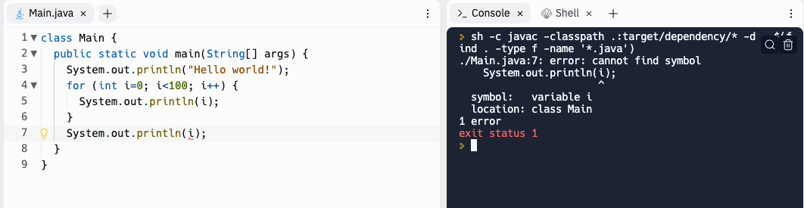
for syntax
for (initialization; condition; increment)
statement
initialization may also declare variables
The scope of any variable declarations is purely the for loop itself.
for (int i = 1; i <= 100; i++) {
System.out.println(i);
}

Slide 19
for syntax
for (initialization; condition; increment)
statement
The last example started a counter at 1, which can be done. But like most things in Java, and computer science in general, counters usually start at 0 by convention. It makes interfacing with other code and data structures more straightforward.
for (int i = 0; i < n; i++) {
doSomething(i);
}
Generally not…
for (int i = 1; i <= n; i++) {
doSomething(i);
}

Slide 20
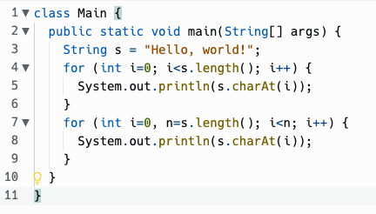
for syntax
for (initialization; condition; increment)
statement
initialization could even declare multiple variables. I often declare "int i=0, n=s.length()". Why?

Slide 21
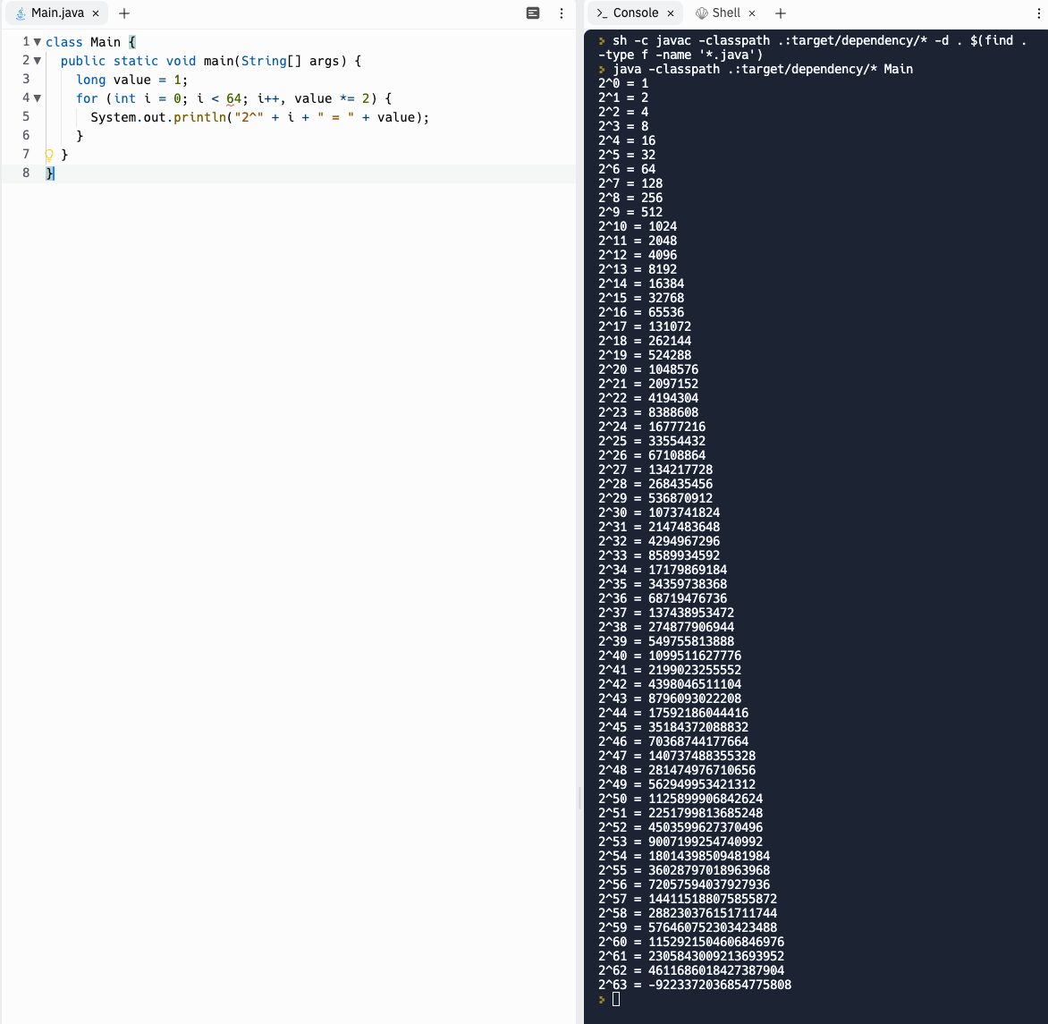
for syntax
The increment expression can use "," to update multiple variables. You can't declare variables of different types in the initialize expression, though.

Slide 22
for syntax
for (initialization; condition; increment)
statement
initialization, condition, and increment are all optional
for (;;) { … }
is an infinite loop, the same as while (true) { … }
Why would you omit initialization?
Sometimes the initialization needed takes multiple statements and can't be easily expressed in a single expression, so you do it before the for loop and omit the initialization.
Why would you omit increment?
Increment logic may similarly get complicated and be better expressed within the body of the loop.

Slide 23
for syntax
for (initialization; condition; increment)
statement
for statements are very frequently used with numeric counters, usually integers.
But they don't have to be… the expressions can be most anything.
// Cast spell to magically look east as far as possible.
for (Room room = player.getLocation();
room != null;
room = room.getEast()) { printRoomContents(room);
}
for is very flexible in this way.
Some languages like BASIC have a FOR statement that only can initialize and increment a numeric counter.

Slide 24
return in loops
You can exit a while or for loop by returning out of the enclosing method. One student wrote this for the TruthGame pickNext method:
public int pickNext() { for (int i=1; i<=3; i++) {
if (isTruth(i)) { return i; } } return -1; }

Slide 25
break
You can also exit a while or for loop and just move on to the next statement after the loop, using break.
while (true) { String command = scanner.nextLine(); if (command.equals("quit")) { break;
} … } System.out.println("Well, goodbye, then!");

Slide 26
continue
The continue statement jumps back to the top of the loop and re-evaluates the condition. It's useful for skipping the body of the loop, like to ignore blank lines. Otherwise, you'd need a big if/else. It works in while, do/while, or for loops.
while (scanner.hasNextLine()) { String line = scanner.nextLine(); if (line.equals("")) { continue;
} processNonEmptyLine(line); }

Slide 27
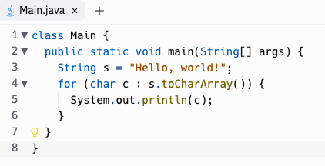
for each loop
In 2004, Java added the "for each loop" or enhanced for loop, which is nice syntactic sugar for iterating over collections. This resembles the for statement in Python which iterates over a sequence.
It'll be covered later in Unit 6… for now, let's focus on the general form of the for statement that we just learned.

Slide 28
Practice!
Replit: ForBuzz
Replit: WordList

